Slide 1
PHEMU 21
(Phénomènes Mutuels 2021) an international observing program organised by the Institut de Mécanique Céleste et de Calcul des Éphémérides (IMCCE), Paris, France (Paris Obs)
Jupiter Mutual Events
Feb 28 to Nov 16
Dave Herald

Slide 2
A mutual event is an eclipse or occultation of one satellite by another satellite
Mutual events can only occur when the plane of the orbits is edge-on to the Earth. For Jupiter, this occurs for a 12-month period every 6 years.
Measuring/analysing the light curve leads to very precise measurements of the relative positions of the satellites. These can be used to improve our knowledge of the orbits, and long-term orbital variations

Slide 3
Despite there having been several spacecraft orbiting Jupiter, these observations remain very important for measuring long-term variations in the motion of the satellites

Slide 4
Occult functionlity
Occult has functionality to predict events – under the Satellite Phenomena tab
The predictions:
  can be limited to those visible at your location
  show expected light curves
  illustrate the curcumstances

Slide 5
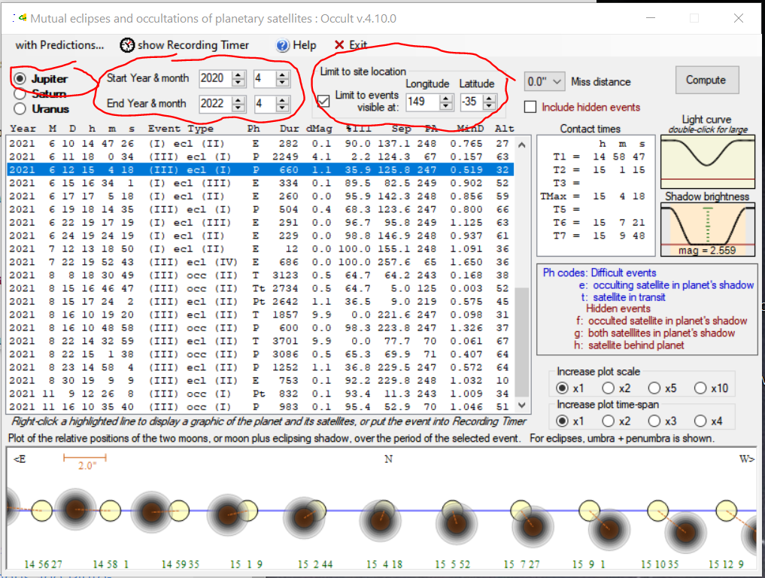
Set Planet, Date range, & your location

Slide 6
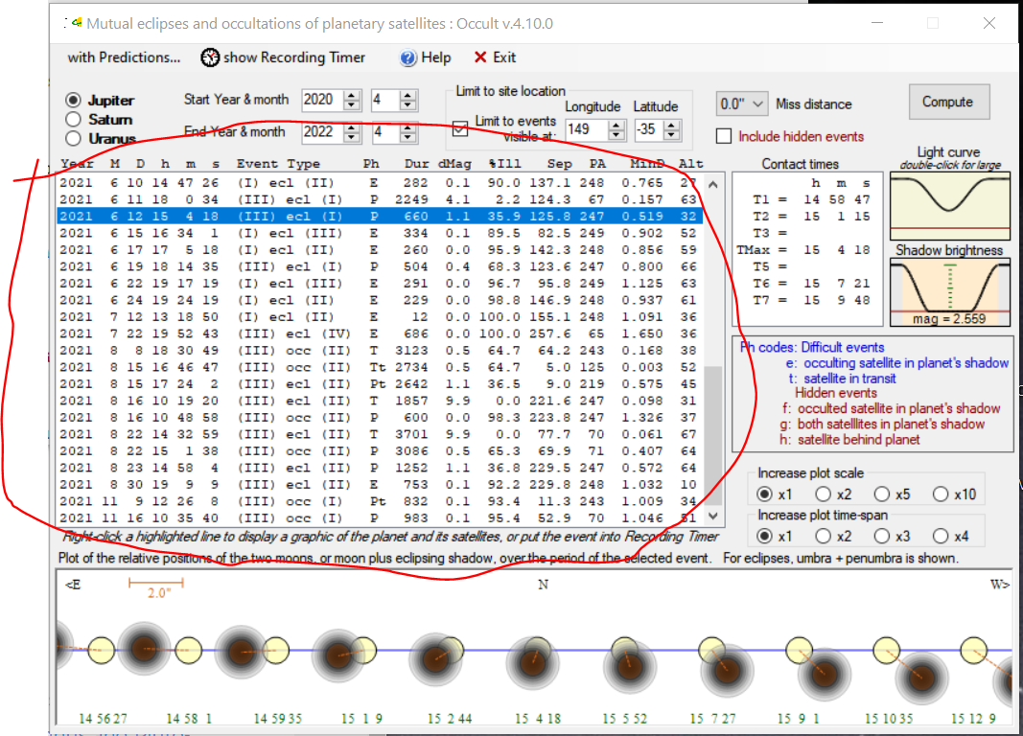
List of events. Select an event to see the details

Slide 7
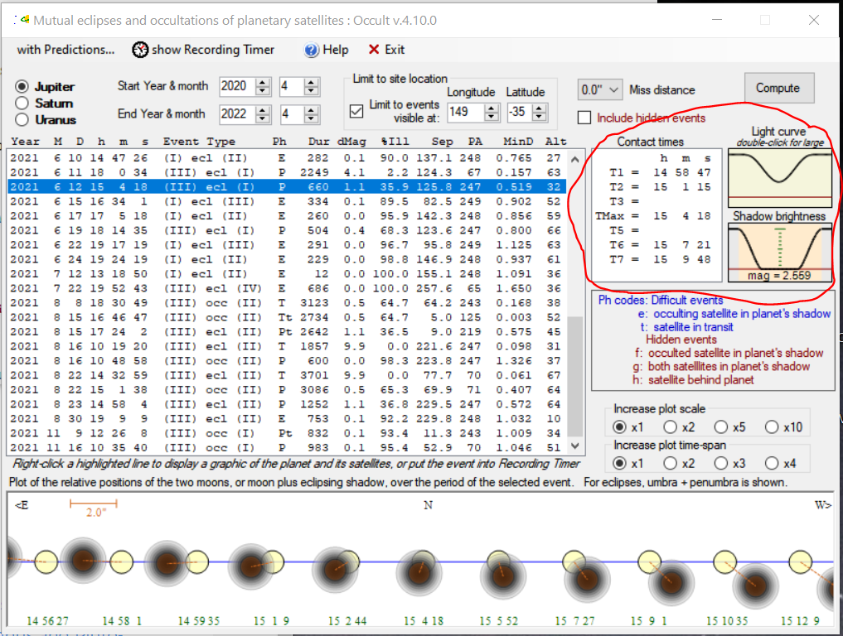
Contact times, expected light curve, and shadow brightness (for eclipses)

Slide 8
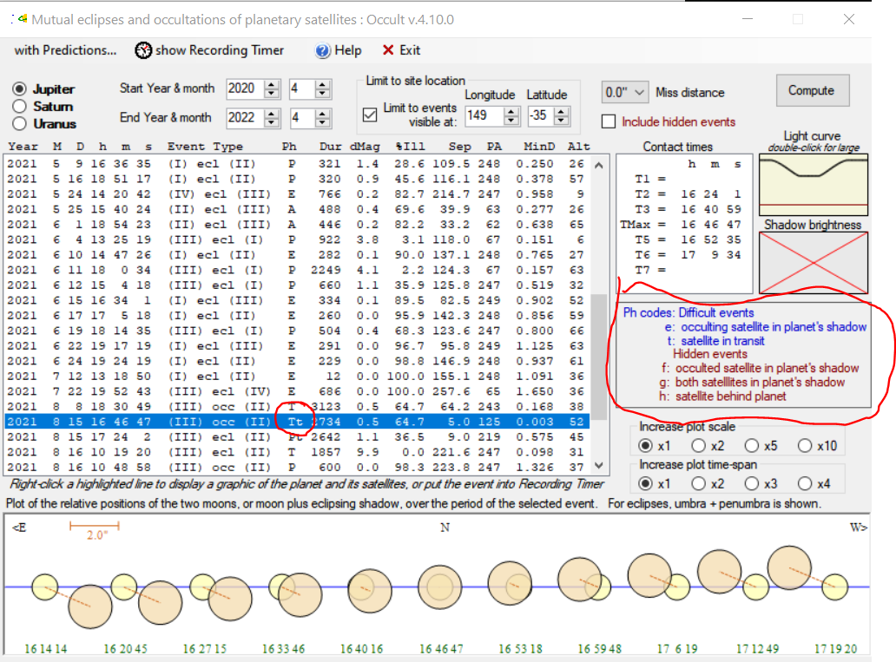
Some events are difficult to observe, or are ‘hidden’
Example: III occ II [Tt] is a Total occultation occurring while the moons are transiting Jupiter

Slide 9
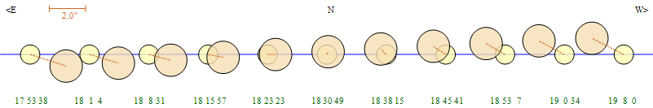
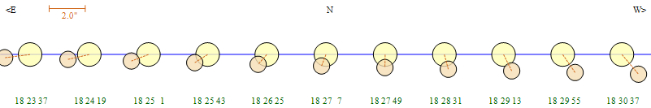
Example occultations
Total occultation of Ganymede by Europa – 2021 Aug 8, Durn 52 mins
Partial occultation of Ganymede by Io – 2021 Apr 12, Durn 5 mins

Slide 10
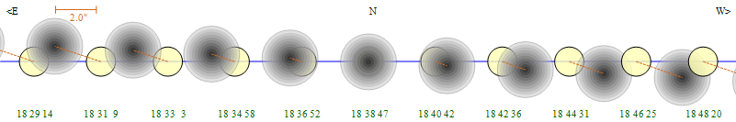

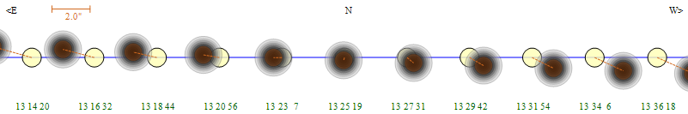

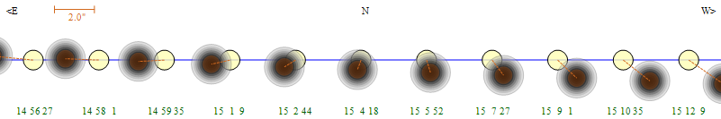

Example eclipses
Full annular eclipse of Ganymede by Callisto – 2020 Apr 19. Durn 13 mins
Full total eclipse of Io by Ganymede – 2020 Jun 4. Durn 15 mins
Partial total eclipse of Io by Ganymede – 2020 Jun 12 Durn 11 mins

Slide 11
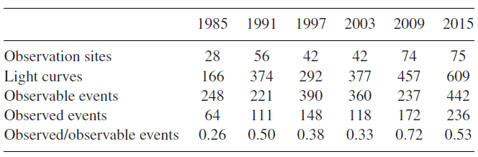
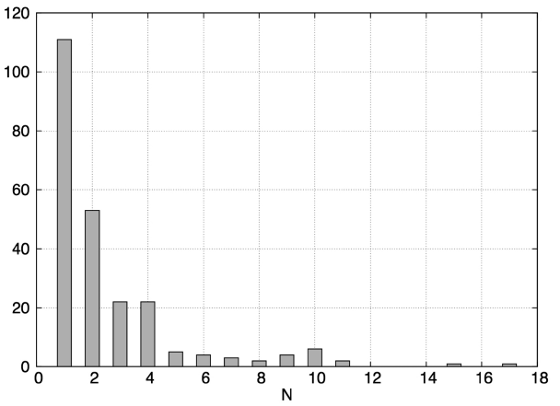
Results from previous seasons
For the 2015 season:
442 events were ‘observable’
236 different events were observed, at 75 sites
609 light curves obtained and reduced
Plot of number of events against
number of observers

Slide 12
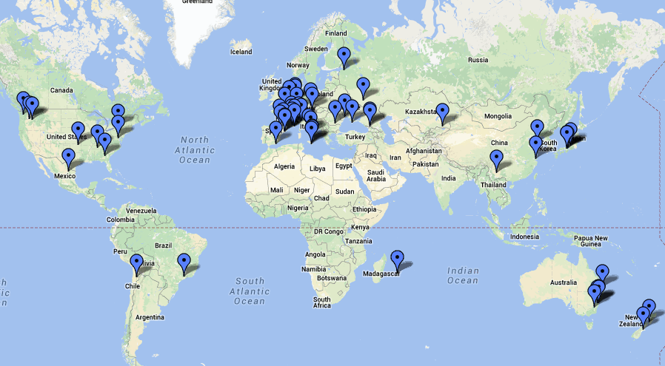
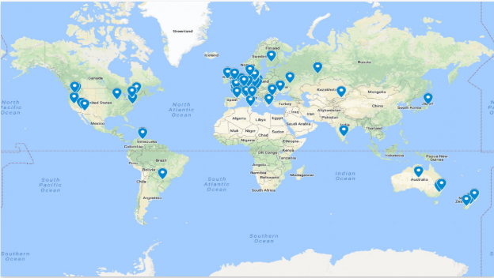
Observer locations
2009
2015

Slide 13
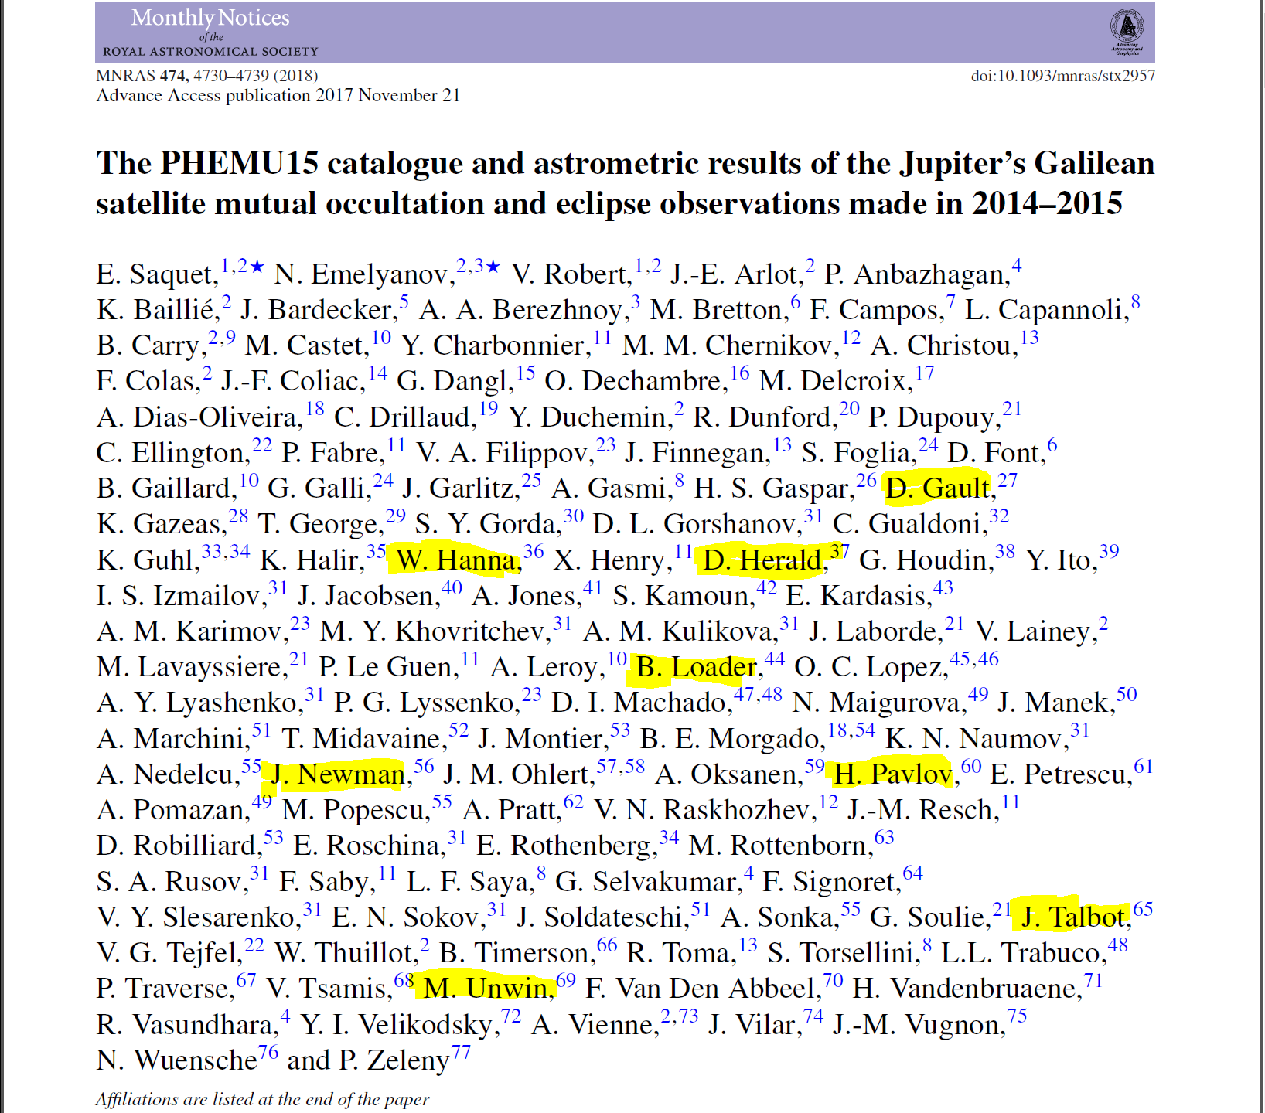
All observers get to be a joint author of a paper
(Australasian observers highlighted)

Slide 14
Observing requirements
Driven Telescope (but need not be equatorial)
Time to 0.1 secs UTC – GPS, NTP**, WWVH
Video with time stamp
  Can achieve this by recording to a VCR, with VCR time stamp recording enabled. But need to check correction to VCR clock at start and end.
Recorder – VCR, Computer
Frame grabber – to convert to a .avi file

Slide 15
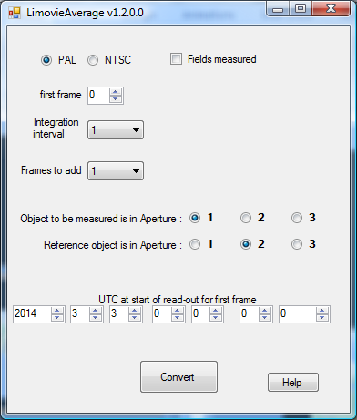
Measuring tools
Limovie, or Tangra
LiMovie Average (or its successor) to improve measurements by binning and normalising
http://www.asteroidoccultation.com/observations/LimovieAverage.zip
http://www.asteroidoccultation.com/observations/LiMovieandMutualEvents.txt

Slide 16
Reporting
Observations reported online to IMCCE
  {effectively, Paris Observatory} using:
  http://www.sai.msu.ru/neb/nss/phemuobsai.htm
Simple text report (standard form) with attached .csv and optional plot, using the form downloaded from
https://www.imcce.fr/content/medias/recherche/campagnes-observations/phemu15/fiche-obs-phemu-v3-fr.txt

Slide 17
Observing issues
Need to compress the video when creating the avi file – otherwise the file will be HUGE
Concerns about linearity of the video camera. Where possible, make sure the Gamma is set to 1.
Image motion – minimise. In particular, any vignetting across the field will cause light variations if there is significant image movement

Slide 18
Observing issues 2
IMCCE recommend the use of a red filter – reduce sky background
For events close to Jupiter’s limb – experiment with a Methane filter (if you happen to have one – they are expensive!). But exposures will have to be much longer
Highly desirable to have several independent observations of the same event
Best to avoid saturated images of the satellites – but no concern if the saturation is not great.

Slide 19
Observing issues 3
Closeness to Jupiter can create problems with correcting for sky background, which will have a 2nd-order variation with distance from Jupiter. Aperture sizes and shapes can affect the measurement result.
  Tangra may be improved to model the glare from Jupiter, to improve background subtraction

Slide 20
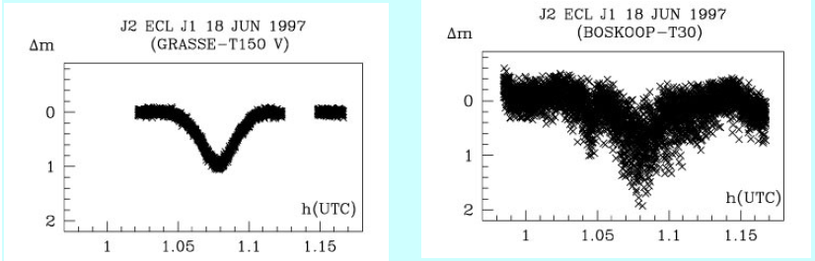
Example light curves (from IMCCE)
    Good Bad

Slide 21
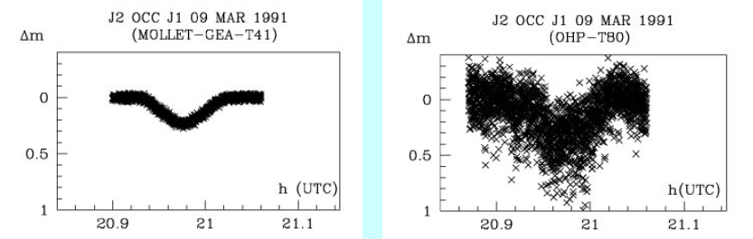
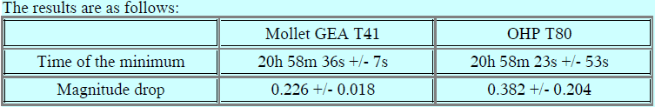
Example light curves (from IMCCE)
    Good Bad

Slide 22
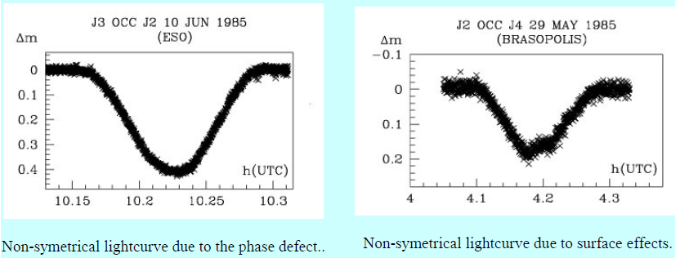
Example light curves (from IMCCE)
Non-symmetrical light curves, due to:
Phase defect Surface effects

Slide 23
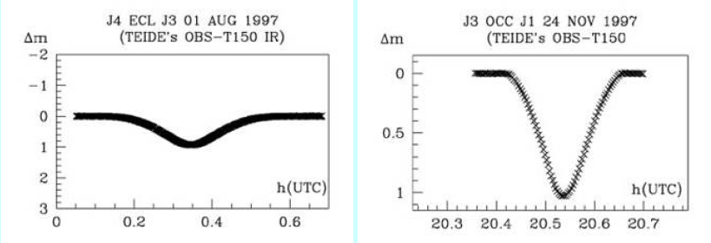
Example light curves (from IMCCE)
The beginning and end of an eclipse is smoother than for an occultation
Eclipse Occultation

Slide 24
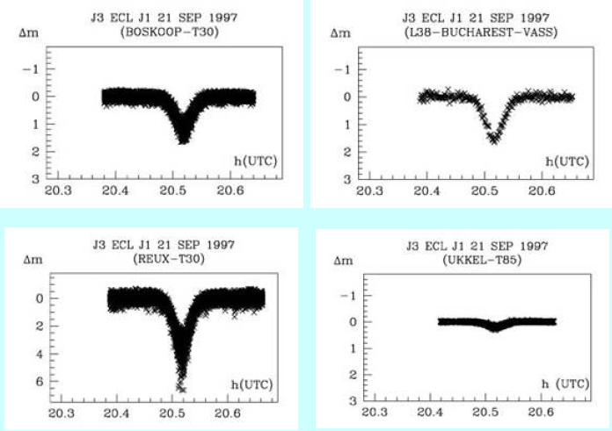
Example light curves (from IMCCE)
Need to be careful with calibrating the light level
4 light curves of the same event...!!

Slide 25
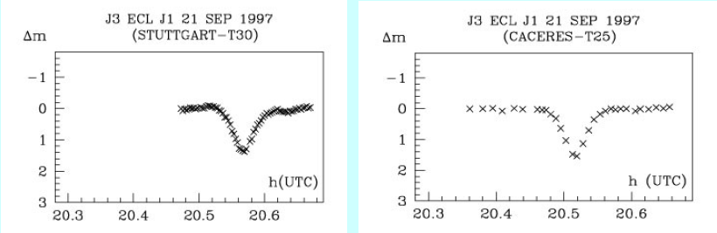
Example light curves (from IMCCE)
Need to be careful about time – if not using GPS video insertion
Two light curves of the same event – but different time!

Slide 26
Summary of events visible from Eastern Australia & New Zealand
2021 | # events | 2021 | # events
Mar | 3 (2 ecl, 1 occ) | Jul | 2 (2 ecl, 0 occ)
Apr | 15 (13 ecl, 2 occ) | Aug | 9 (5 ecl, 4 occ, with 2 pairs of simultaneous ecl Occ)
May | 5 (5 ecl, 0 occ) | Nov | 2(0 ecl, 2 occ)
Jun | 10 (10 ecl, 0 occ) | Total | 46
Jupiter at opposition 2021 Aug 21
Two events occur while the satellite transits Jupiter’s disc
2021 Aug 15 (III) occ & ecl (II) 2021 Nov 9 (III) occ (I)
Overall, this series season of mutual events has far fewer opportunities than the last 6 series – so make the most of the events that are available!

Slide 27
More info & guidance
IMCCE has a dedicated web page at:
https://www.imcce.fr/recherche/campagnes-observations/phemus/phemu#1

Slide 28
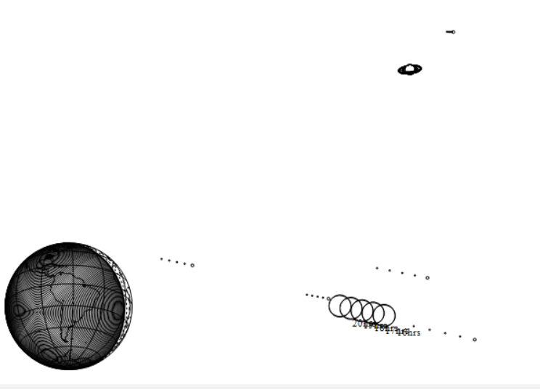
A different ‘mutual’ event
The close approach between Jupiter and Saturn on 2020 Dec 21 @18.4h
Plot shows Jupiter + Galilean moons – moving relative to Saturn + Titan, at 1hr intervals
Minimum distance between disks
5.7 arc mins. Both planets will be in
the same field of view!
Earth plot – shows closest separation will be visible from western Europe
Solar elongation: 30° East
Best time in Australasia – soon after sunset on Dec 21 or 22

Slide 29
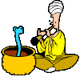


Questions?

